Slide 1
DSA5104
Airbnb dataset analysis project
Group Member: Dai Linghao, Liu Boyu, Liu Yu

Slide 2
Table of Content
Project background
Know the data
Clean the data
Store in relational database management system
Store in MongoDB
Requirement analysis
Insights and Summary

Slide 3
1. Project Background

Slide 4

Project background
This project prepares and stores data from Airbnb accommodation listings in Bangkok, Thailand in:
a relational database management system
a no-relational database called MongoDB
By practicing our data gathering, processing, storage, and access skills, it helps us to gain a better grasp of how data management functions in practical applications.
Notes:
This report prepares and stores data in a relational database management system and a no-relational database MongoDB using open data source from Airbnb accommodation listings in Bangkok, Thailand. By practicing our data gathering, processing, storage, and access skills, we were able to gain a better grasp of how data management functions in practical applications.

Slide 5
2. Know the data

Slide 6
2. Know the data
The Airbnb data set consists of 3 csv dataset:
Listing.csv: The information about the listing posted on Airbnb.
Review.csv: The information about the customer review posted on Airbnb.
Calendar.csv: The information about the listing availability and price.
Through analyzing the meaning of every column, the 3 datasets have been further divided into 6 tables:
listing table: Separated from listing.csv, contains all information other than host.
host table: Separated from listing.csv, contains information about the host.
review table: Separated from review.csv, contains information other than reviewer.
reviewer table: Separated from review.csv, contains information about the reviewer.
calendar table: Contain all information in calendar.csv
transaction table: A self-generated table related to transaction records.

Slide 7
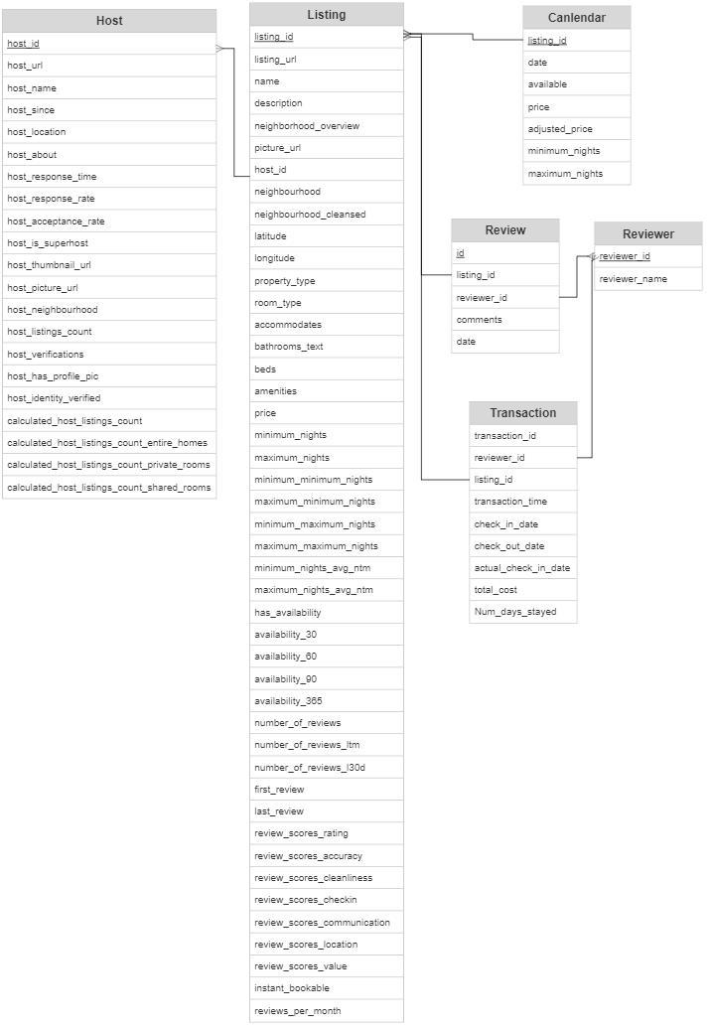
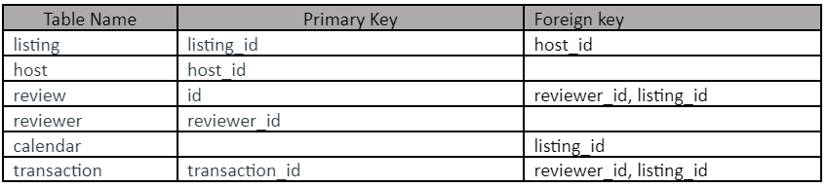
2. Know the data - schema diagram
With the understanding of the meaning and date type of each attribute, and the referential relationships among tables, the schema diagram was generated.
Here is the referential relationship summary:

Slide 8
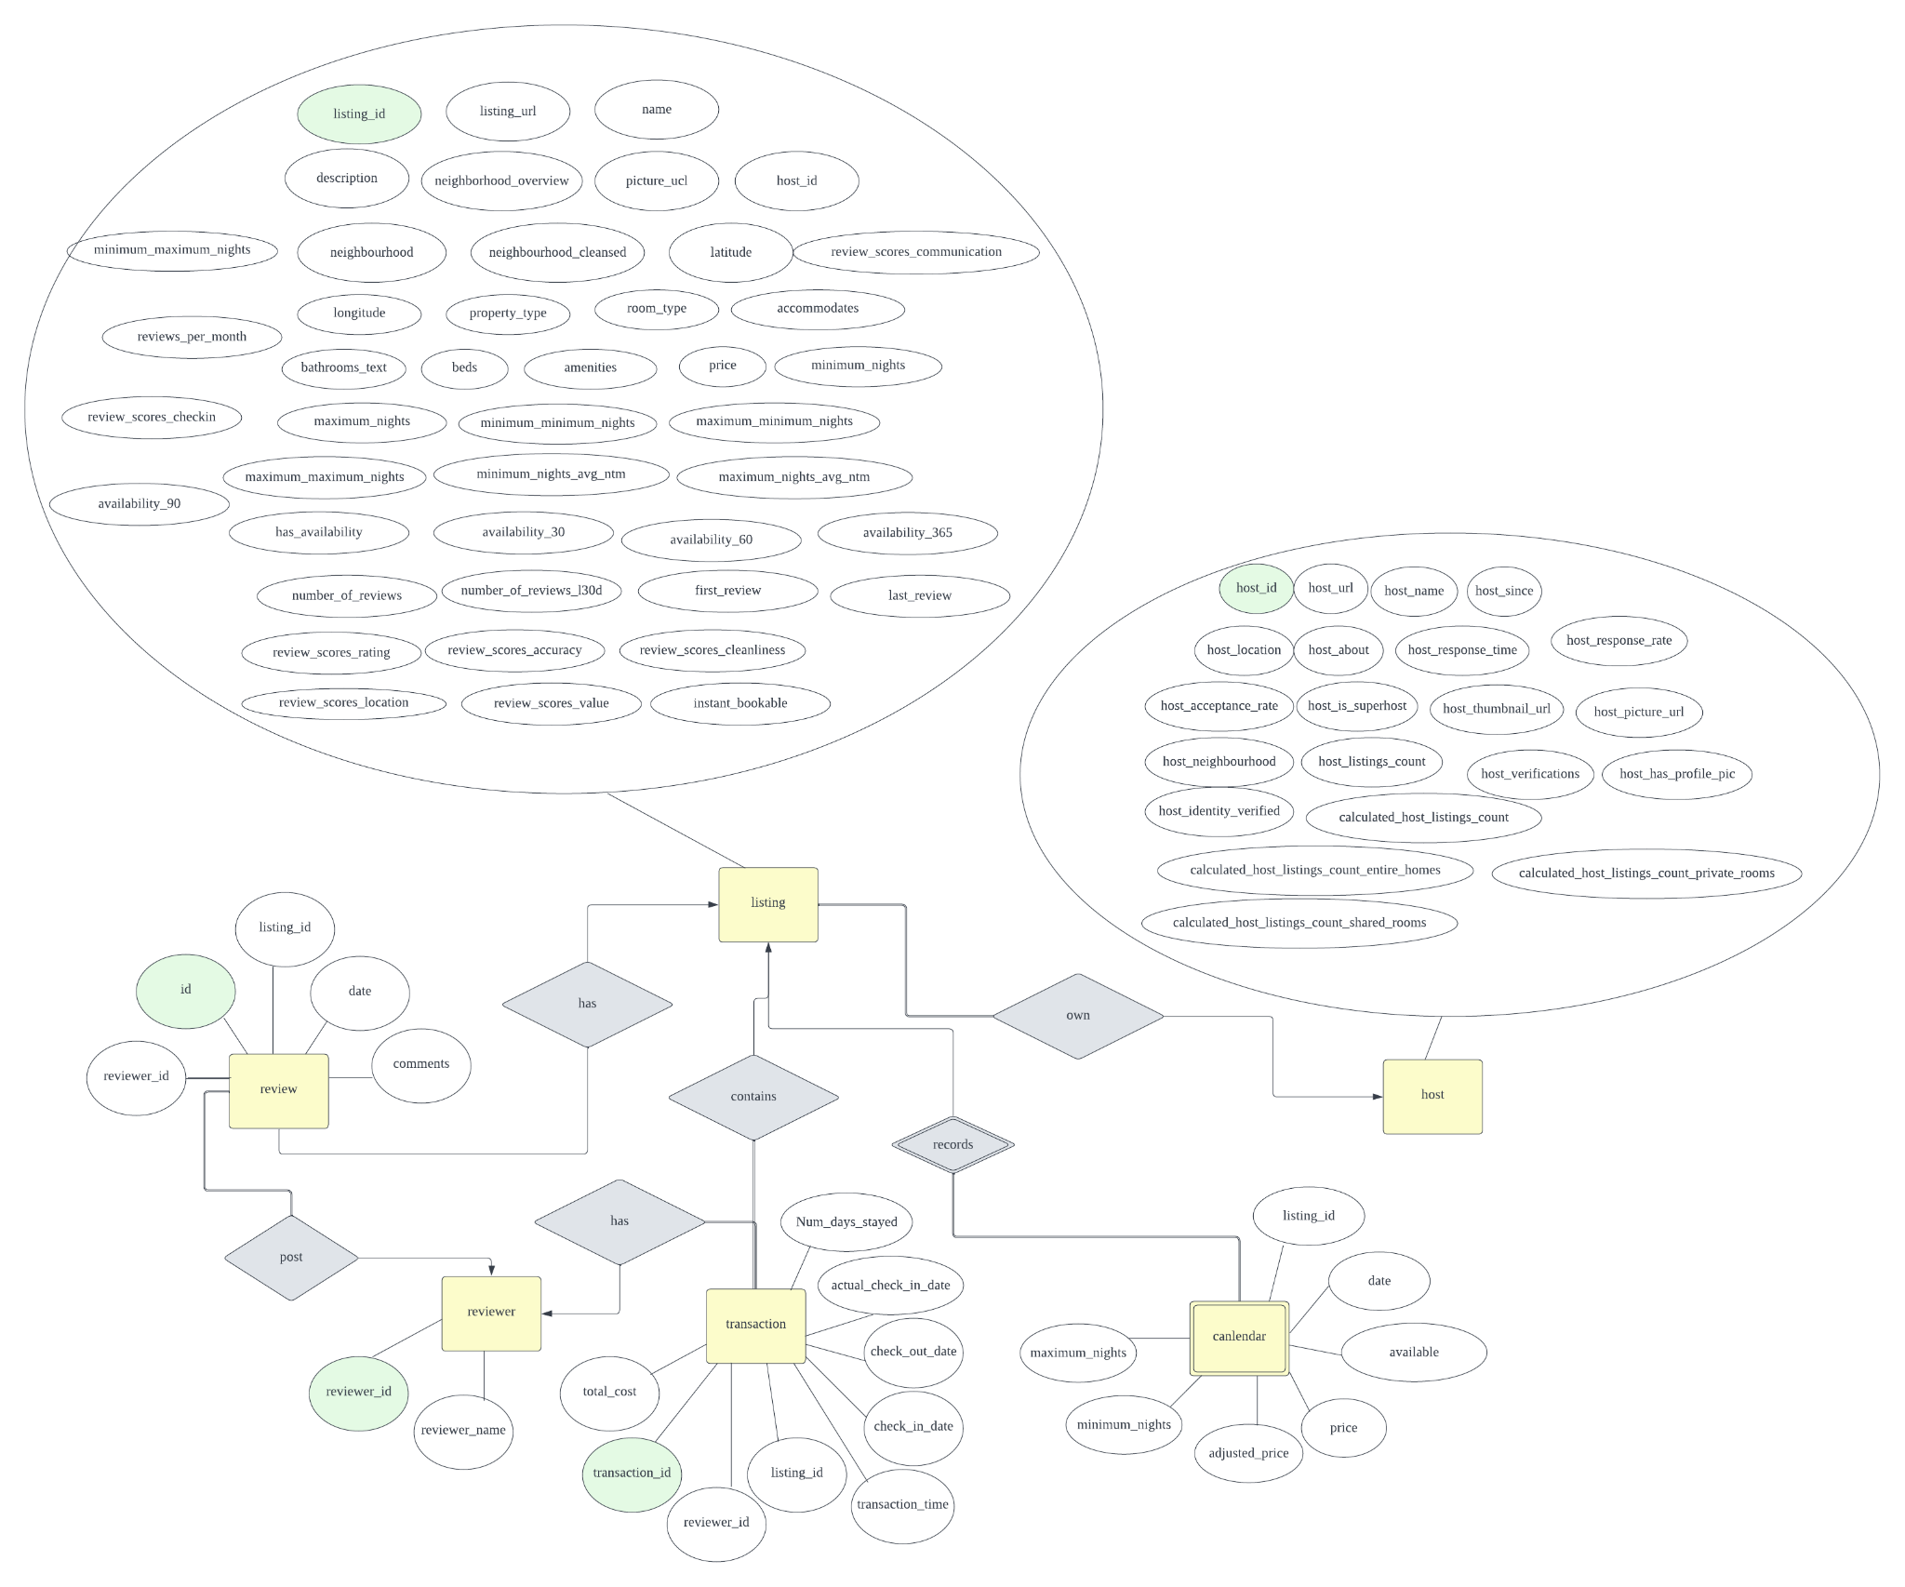
2. Know the data - ER diagram
With the understanding of the meaning and date type of each attribute, and the referential relationships among tables, the ER diagram was generated as well.

Slide 9
3. Clean the data

Slide 10
3. Clean the data
Listing Data
Drop columns that are either
Only have one distinct value
Identical to another column
Only contain null values
Remove NA for columns that are
By right should not have any null values (e.g. host_name)
Number of NA values are acceptable
Fill NA for columns that are
By right should not have any null values
Exists a common values suitable for all null values
Cast column types
Cast to numerical for ‘price’
Cast to boolean for columns only contains ‘t’ and ‘f’

Slide 11
3. Clean the data
Review Data
24 rows in ‘comment’ contain null values and 2 rows in ‘reviewer’ has null values
Directly perfor pandas ‘dropna’
Calendar data
Only 2 rows in ‘minimum_nights’ and ‘maximum_nights’ is missing
Convert ‘price’ and ‘adjusted_price’ from string type to numeric type
Convert ‘available’ column from string type to boolean type

Slide 12
4. Store in relational database management system

Slide 13
4. Store in relational database management system
As mentioned in the schema diagram, we in total created six tables
Listing table
Data comes from listing data, with selected columns that are related to listings
Host table
Data comes from listing data, with selected columns that are related to hosts
For example, ‘host_name’ and ‘host_is_superhost’
Reviewer table
Reviewer data retrieved from review data such as reviewer id and reviewer name
Review table
Data from review data, containing comments, reviewer id, date and more

Slide 14
4. Store in relational database management system
As mentioned in the schema diagram, we in total created six tables
Calendar table
Data from calendar indicating the availability of each listing on each date
Transaction table
Data manually generated based on existing data
Based on review data
Generate a check-in date that is prior to review date 3 - 20 days
Generate an actual check-in date that is behind planned check-in date 0-2 days
Generate a check-out date that is prior to review date 0-(review_date - actal_check-in date) days
Generated a transaction date (booking date) that is 3 - 100 days prior to the planned check-in date

Slide 15
Check for BCNF
Listing
R (listing_id,listing_url, name, description, neighborhood_overview, picture_url, host_id, …) FDs: listing_id -> *,
listing_url -> *
Both of the two dependencies do not violate the BCNF
Host
R (host_id, host_url, host_name, host_since, host_location, host_about, …)
FDs: host_id -> *, host_url -> *
Both of the two dependencies do not violate the BCNF.
Review
Decompose R (id, listing_id, reviewer_id, comments, date)
FDs: id -> *
The dependency does not violate the BCND

Slide 16
Check for BCNF
Reviewer
R (reviewer_id, reviewer_name)
FDs: reviewer_id -> reviewer_name
The dependency does not violate the BCNF
Calendar
R (listing_id, date, available, price, adjusted_price, minimum_nights, maximum_nights)
FDs: listing_id + date -> *
The dependency does not violate the BCNF
Transaction
R (transaction_id, reviewer_id, listing_id, transaction_time, check-in_date, check-out_date, actual-check-in_date, total_cost, num_days_stayed)
FDs:transaction_id -> *
The dependency do not violate the BCNF

Slide 17
5. Store in non-relational database management system

Slide 18
5. Store in non-relational database management system
MongoDB
BSON documents stored in collections
Flexible schema
Mongo compass with clear GUI
HBase
Column-oriented based on HDFS
Store large datasets
Analyse data fast
Notes:
MongoDB supports a key-value pair data concepts. It stores data in collections, which are a group of BSON documents. Therefore, MongoDB is able to store flexible schema documents in a more efficient way. Such design helps MongoDB to improve the speed of queries. Also, MongoDB compass provides a clear GUI for users.
HBase is a column-oriented non-relational database management system that runs on top of Hadoop Distributed File System (HDFS), which enables it to store and handle large datasets, and provide analysis in a short period. However, there are no certain query language for HBase, which makes the query process a bit more complicated compared to MongoDB.
Therefore, MongoDB is selected as our non-relational database to store the Airbnb data.

Slide 19


5. Store in MongoDB
We stored six collections in total into MongoDB
Extracted from listings
Listing
Host
Extracted from reviews
Reviews
Reviewers
Extracted from Calendar
Calendar
Self-generated
Transactions
Notes:
For the database, we stored 6 collections: host, listing, review, reviewer, calendar and transaction. Transactions data are generated by ourselves based on reviews data. Others are extracted from the corresponding datasets
These collections are firstly generated using python and saved in csv format.
Then, they are imported into MongoDB using the compass GUI. The types of each feature are also specified correspondingly.

Slide 20
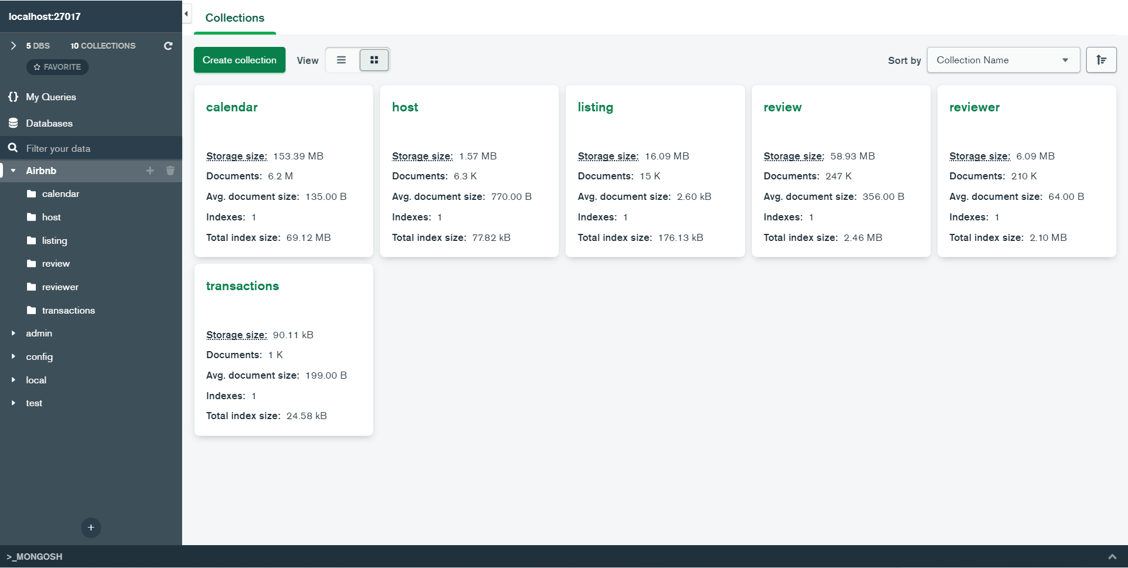
5. Store in MongoDB
Notes:
After importing this is the structure of our MongoDB.

Slide 21
6. Requirement analysis

Slide 22
6. Requirement Analysis
Benefits of building databases: can quickly gain desired insight from the dataset.
Divide the stakeholders into 3 groups based on their :
Group 1: Airbnb, Airbnb company itself
Group 2: Hosts listing host using Airbnb
Group 3: Customers, the users who use Airbnb to book for listings
Notes:
Different stakeholders can easily obtain their own relevant useful information for decision-making by employing queries to fetch necessary information from the database.
Because different stakeholders may be interested in different information, we have divided them into three groups and list out possible information that each group might be interested in separately.

Slide 23
Group 1: Airbnb
What are the most common property types available?
What are the top and bottom 10 property types based on average price?
What are the top and bottom 10 property types based on review score?
As the owner of this online lodging market, Airbnb may be interested in determining the trend of property types available on its website in order to gain a clear orientation for itself.
Notes:
Here are some questions that group 1 might be interested in

Slide 24
Group 2: Hosts
Who are the top 10 hosts based on total revenue?
What is the number of hosts joined every month?
What is the most commonly verified host information?
Who are the top 10 hosts with the most listings?
As listing hosts, they may like to gather information that will assist them in determining how to be verified as a host, how to be a good host, and how to generate revenue. The hosts may also be interested in seeing whether more competitors appear.

Slide 25
Group 3: Customers
What are the top 10 listings with the lowest price?
What are the top 10 listings with the highest number of reviews?
What are the top 10 listings with the highest rating score?
What are the top 10 listings with the highest cleanliness score?
What are the top 10 listings with the highest location score? (best location)
What are the top 10 hosts that have the highest response rate?
Can a customer find whether the host of a reviewed listing has other listings that are available within the same given date range?
Customers will be more interested in whether they have found satisfied good hosts and listings, which they can judge by referring to the rating score of different aspects.

Slide 26
7. Insights and Summary

Slide 27
7. Insights and Summary
Based on the requirement analysis, both mysql and MongoDB queries are used to retrieve the information that each group needed. Here are some interested insights from queries results:
The most common property types available on Airbnb, as well as the property types that have highest scores, are entire units or private rooms, with shared rooms being rare.
In 2010, the number of newly joined hosts every month was small, which indicates that the competition for new hosts might not be so fierce.
The hosts with the most listings are not the hosts that earned the highest revenue.
The listings with highest location scores have a high tendency to be near the BTS Line, which is the skytrain of Bangkok. It might imply that many consumers will consider transportation convenience when choosing a listing.

